Slide 1


Deep Fake Identification
An AI-powered Platform Designed to Differentiate Between Real and Fake Contents.
Presented By
Swarnadri Sekhar Mukherjee Deb kumar Mondal Soumyadeep Shaw
Meet Kasediya Tanya Kumari Sunny Kumar Prabhjot Kaur Arya Gupta
Under Guidance of
Mr. Harjaspreet Singh
To
SABUDH FOUNDATION
Date of Reporting:
Dec 16th 2025

Slide 2
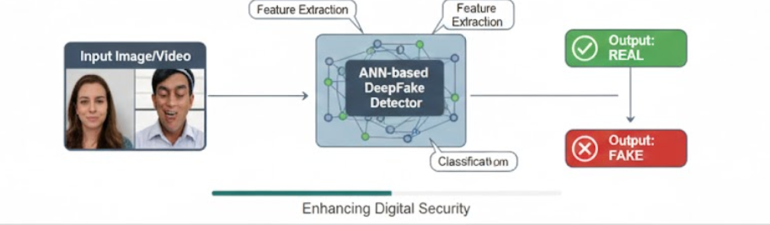
Problem Statement :-
With rapid advancements in Artificial Intelligence, DeepFake technology can generate highly realistic synthetic images that are difficult to distinguish from real ones. While useful, this technology poses serious risks such as spreading misinformation, creating deceptive content, and violating personal privacy.
Objective:
To develop an ANN-based DeepFake detection system that analyzes image features and accurately classifies images as real or fake, enhancing digital security and trust online.

Slide 3
Datasets :-
Datasets were collected from the papers we reviewed in Literature Review and merged into a single dataset:
StyleGAN / StyleGAN2 DeepFake Face Images
Real vs Fake Face Images
DeepFake and Real Images
Final Dataset Size:
Real Images: 65,558, Fake Images: 77,954
Dataset Name | Dataset Link
StyleGan-StyleGan2 Deepfake Face Images | https://www.kaggle.com/datasets/kshitizbhargava/deepfake-face-images
Real vs fake faces | https://www.kaggle.com/datasets/uditsharma72/real-vs-fake-faces
Deepfake and real images | https://www.kaggle.com/datasets/manjilkarki/deepfake-and-real-images?

Slide 4
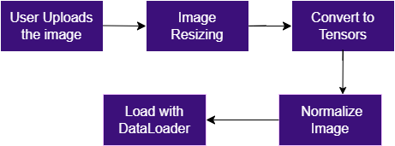
Image Preprocessing Steps :-
Data Cleaning
Removed corrupted images using the PIL library and eliminated duplicate images via MD5 hash-based comparison
Image Organization
Structured images into separate Real and Fake directories
Image Augmentation & Normalization
Resized images to 224 × 224
Applied random flips and rotations
Adjusted brightness and contrast using ColorJitter
Converted to tensors and normalized (mean = 0.5, std = 0.5)
Final Dataset Creation
Consolidated all processed images into a single dataset and Exported the dataset as a compressed ZIP file
Workflow

Slide 5
Methodology :-
Data Collection & Cleaning
Imported real and fake face images and preprocessed them for uniformity.
Feature Extraction
Generated image embeddings using ResNet50 and ViT pretrained models.
Model Training
Fed embeddings into an Artificial Neural Network (ANN) for binary classification.
Evaluation
Compared model accuracy, loss, and performance on test data.
Visualization & Analysis
Analyzed confusion matrix and accuracy curves to understand model behavior.
UI & Deployment
Created a Gradio based UI & deployed on Hugging Face

Slide 6
Methodology Flowchart :-
Image Dataset( Real/ Fake)
User image upload
Data PreProcessing( Resize, Normalize, label encoding)
Image Post Processing
Feature Extraction Models (Resnet, Vit)
Pre Trained AI Model
Embeddings
Prediction Output
Output (Sigmoid) Real(1)/ Fake(0)

Slide 7
Model Performance :-
RESNET MODEL
Achieved 81.64% Test accuracy.
Achieved F1 score of 0.82
Works very good when focus is on local features like pixel level boundaries, color bleeding, blending artifacts, small noise patterns.
Works comparatively good on low quality images.
Detects texture level artifacts very well.
Lightweight model, fast inference.
VIT MODEL
Achieved 88.41% Test Accuracy.
Achieved 0.89 F1 score.
Performs very well detecting inconsistencies like mismatched lighting, unnatural face proportion, global smoothing etc.
High global awareness. Robustness high.
Works very good in high quality images, noisy backgrounds.
Heavy model, little bit slow.
08

Slide 8
Working overview :-
Image Upload and model selection:
Our gradio based UI gives an option to the user to upload the desired image
Thereafter, user can select the preferred model. VIT model and Resnet model are the 2 available options.
Model call:
We have deployed our models on Hugging Face. On selection of the model and image upload, the pipeline comes into act. DeepFake identification takes place detecting the faces.
Output Generation:
The output is shown on the UI along with the detected faces as “Real” or “Fake”.
Confidence of detection is also shown, if user has doubt, user can switch models.

Slide 9
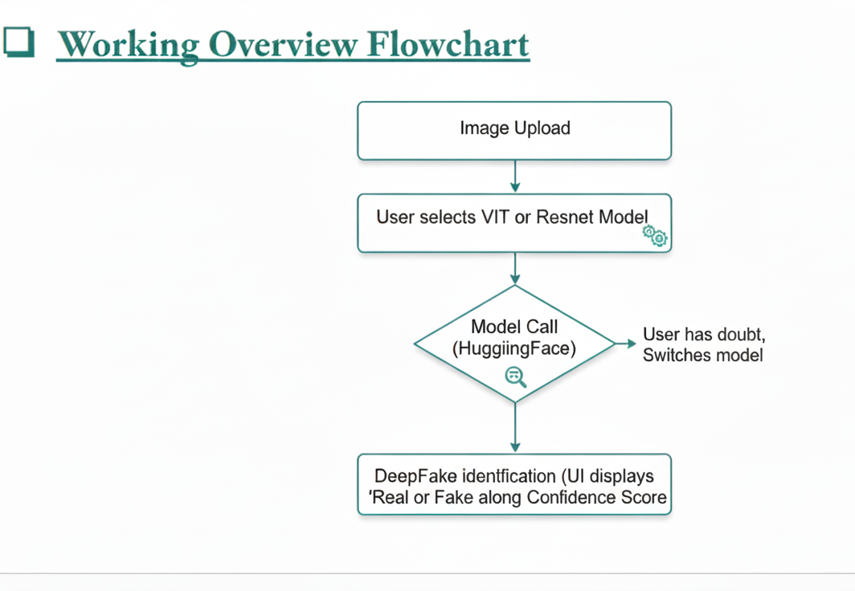
Hugging Face
Hugging Face

Slide 10
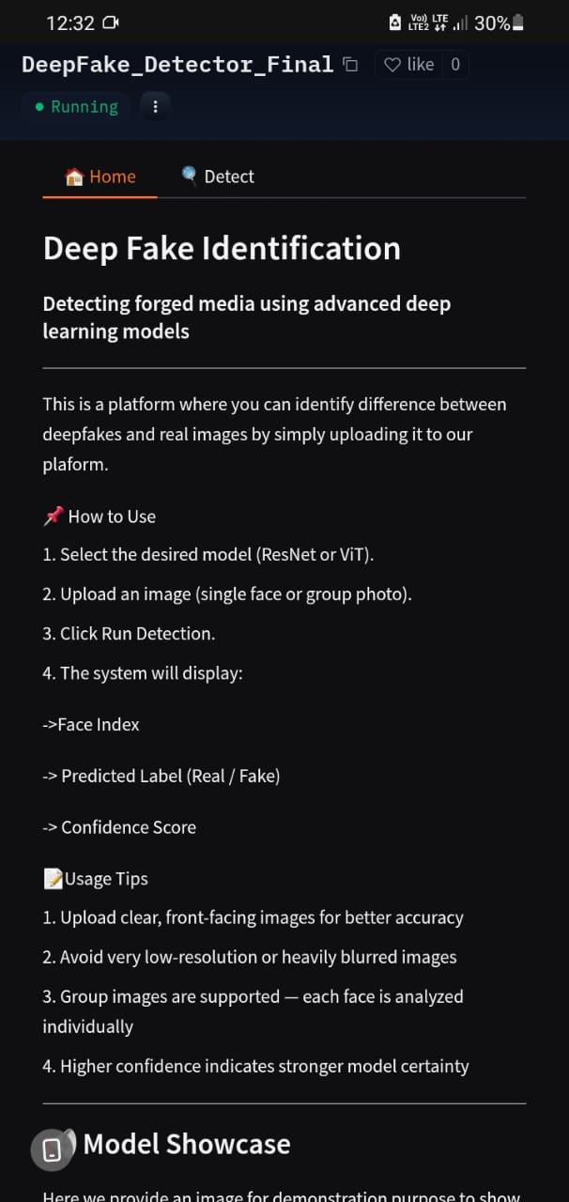
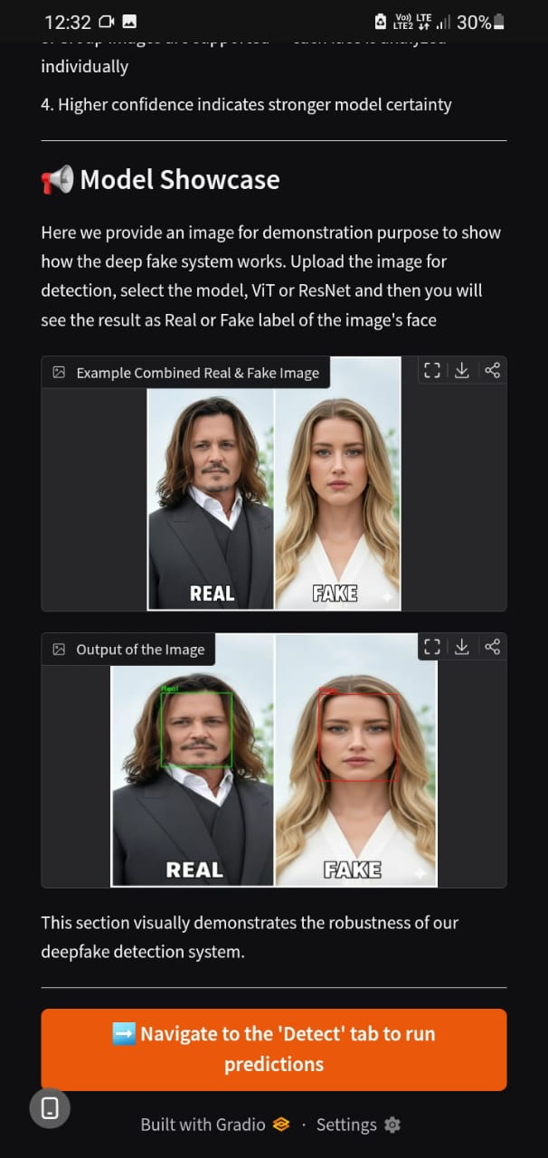
User Interface Demonstration:-

Slide 11
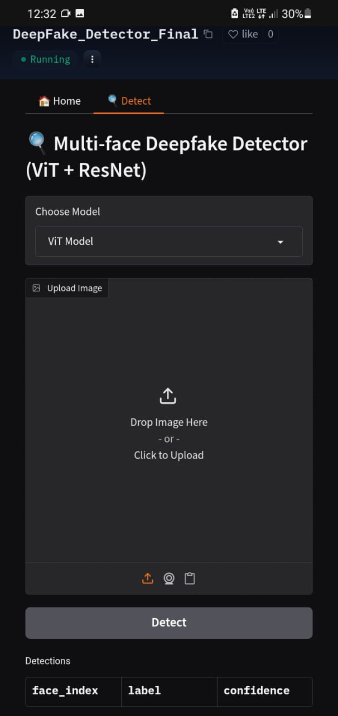
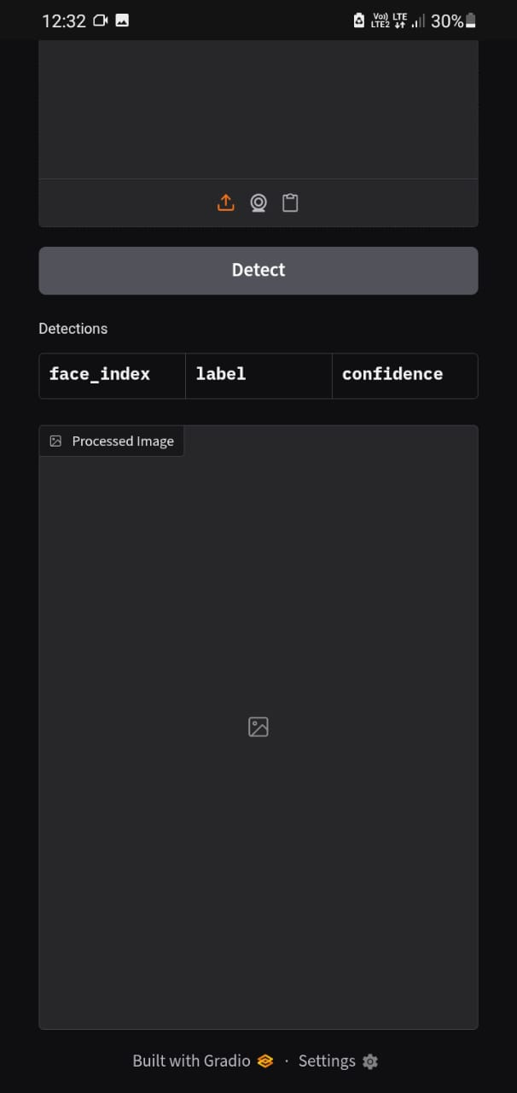
User Interface Demonstration:-

Slide 12
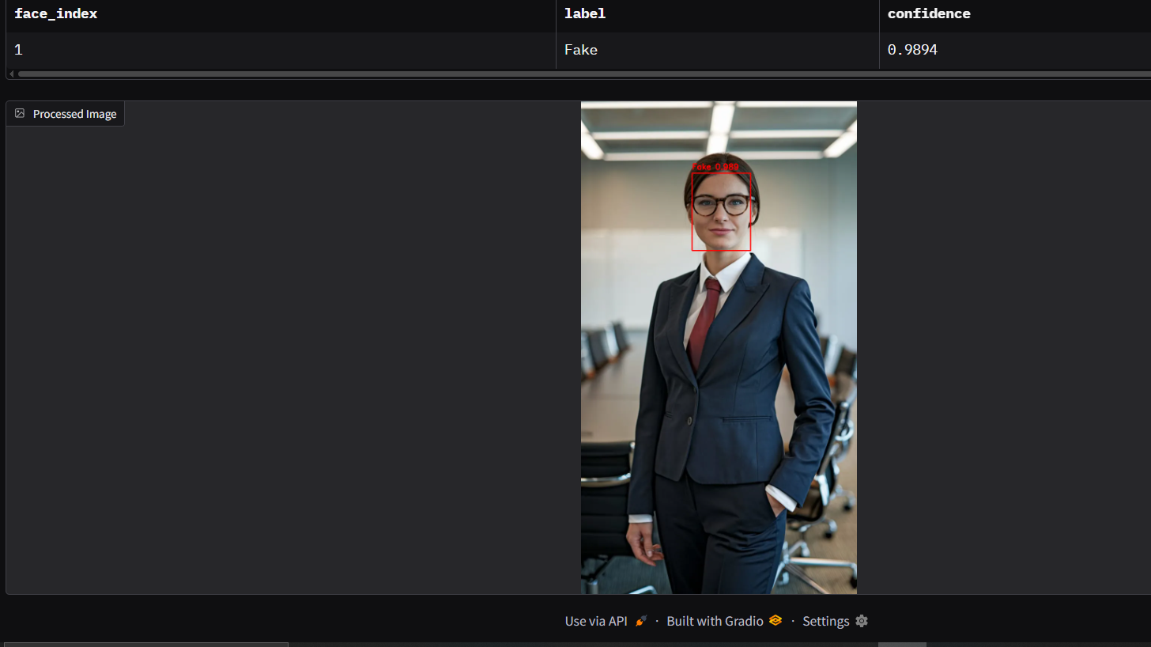
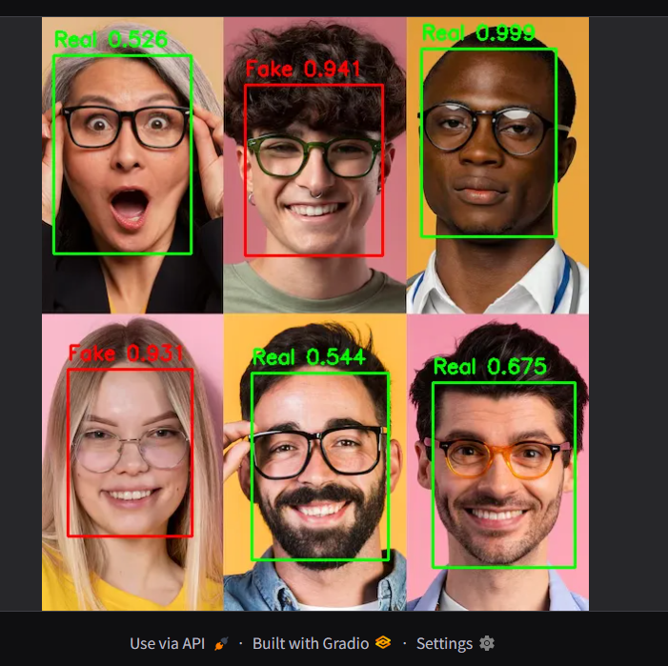
Output Overview :-
Example Output for single person image
Example Output for multiple Faces

Slide 13
Model Deployment Status :-
We have deployed both of our Resnet model an VIT model .
We have deployed them on Hugging Face cloud platform, and running successfully.
The model can easily be accessed through Hugging face.
We can upload any image of our choice, select the model we want and get the relevant output.
Live Link:
https://huggingface.co/spaces/AryaGupta007/DeepFake_Detector_Final
08

Slide 14

Thank You

